Slide 1
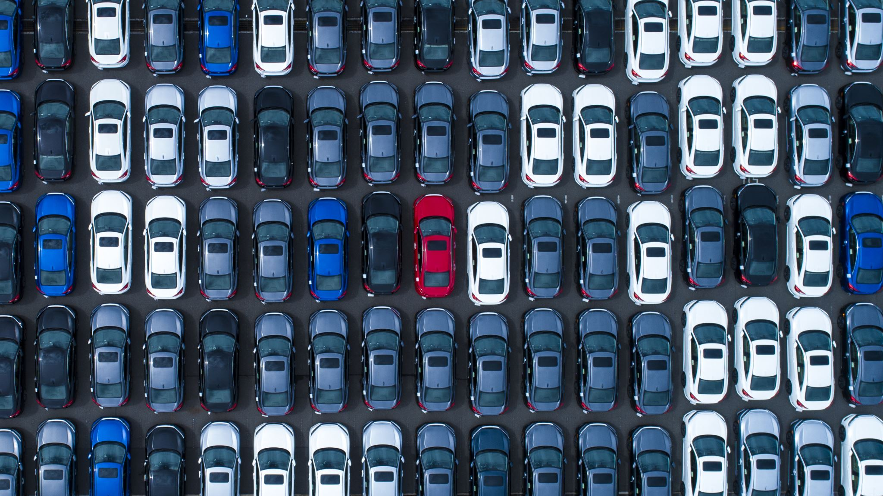
Analysis for Increasing the profit in Second- Hand Car Market
- Academy XI
Notes:
Welcome to the analysis for increasing profit of second hand car retail market. I am avigyan I have done the analysis as a part of academy xi projects. I have collected the data from the past year car sales datasets.

Slide 2

Business Problem
The retailer needed to know how the selling price depends on different variables. An analysis has been performed and the relationship amongst selling price and different variables has been presented as graphs.
Notes:
It’s always better to identify the variables that can alter the main parameter. For this analysis it is selling_price. For the visualization different form of graphs like scatter plot and graph between different varuiables like transmission , present price in the market

Slide 3
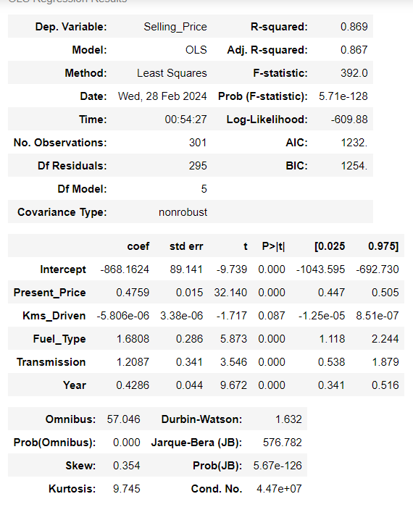
MODEL
SAMMARY

Slide 4
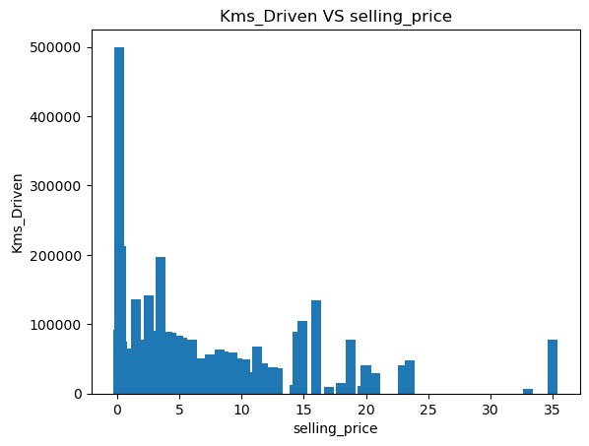
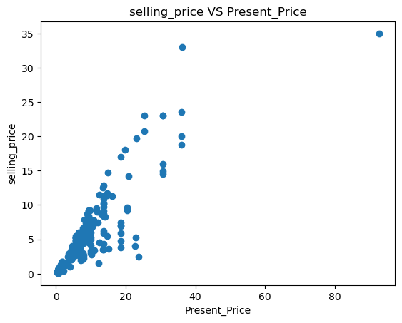
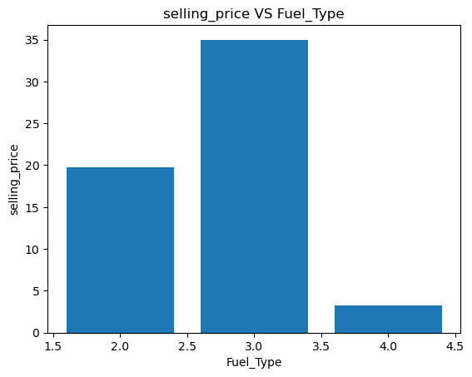
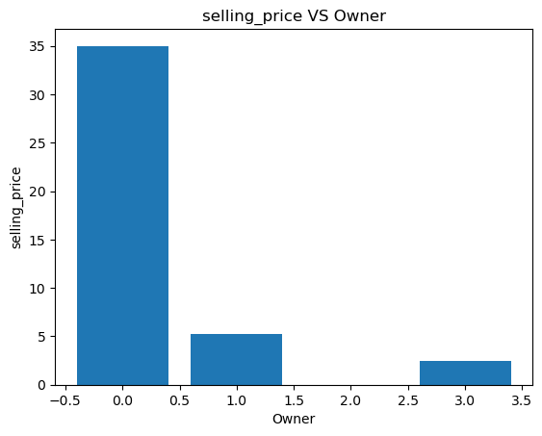
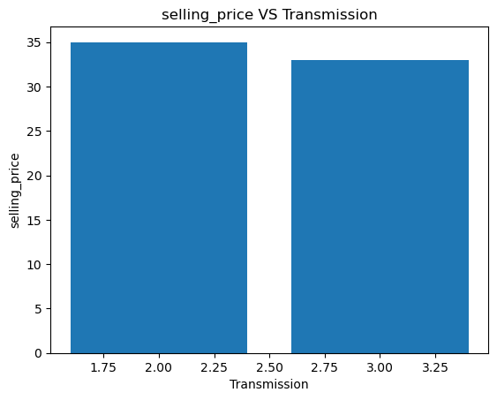
Diesel
Petrol
CNG
Automatic
Manual
Notes:
The cars with less km driven has maximum selling price
The cars with one owner has best price
The car with diesel as fuel is in higher stake of price
Not much diff but still the manual cars have best selling price

Slide 5

Future aspects
Engine Efficiency
Car Performance
Car color and interior
Car Type: sedan, Hatchback, SUV
Notes:
I want to address a few gaps of data in the current dataset like the

Slide 6
Conclusion

Slide 7
Acknowledgement
Rajiv Islam

